Slide 1
Presentation
On
Smart door lock system

Slide 2
Group members
Name : MD Mehedi Hasan Rabbe
ID : 2018200000030
Name : MD Mazidul Islam
ID : 2018200000001

Slide 3
Objectives
The goal of this project is to research and analyze a suitable collection of components for developing a smart door lock using Arduino that provides excellent security and quick access. The following are the specific project goals:
Familiarity with a smart door locking system based on a microcontroller.
Using Arduino to create a simple and smart door locking system

Slide 4
Benefits
In our daily lives, safety is a major concern. Every person requires a sense of safety. Our security pattern includes an access control system for doors. Traditional locks are no longer as secure as they once were; anyone can gain access by breaking these locks. We need to create a system that will assist 24 hours a day, seven days a week. Only authorized individuals have access to restricted areas thanks to a password-based door lock system. Arduino is in charge of the entire system. A keypad can be used to enter the password.The door opens if the password matches the password entered in Arduino. This password-based bolt structure will provide clients with a more secure and low-effort locking-opening mechanism. Mechanical door locks will be replaced by electronic door locks in the future, thanks to the security door lock automation system.

Slide 5
Cost
The estimated cost of our project products is given below(Approximately),
1 Arduino Board = 400 TK
1 4×3 Matrix Keypad = 100 TK
1 PWM Powered Servo Motor= 450 TK
1 16×2 LCD Display = 180 TK
2 LED Light = 5 TK

Slide 6
Apparatus
Hardware:1.
Arduino UNO
4×3 Matrix Keypad
PWM Powered Servo Motor
16×2 LCD Display
Software:1.
Proteus2.
Arduino IDE

Slide 7
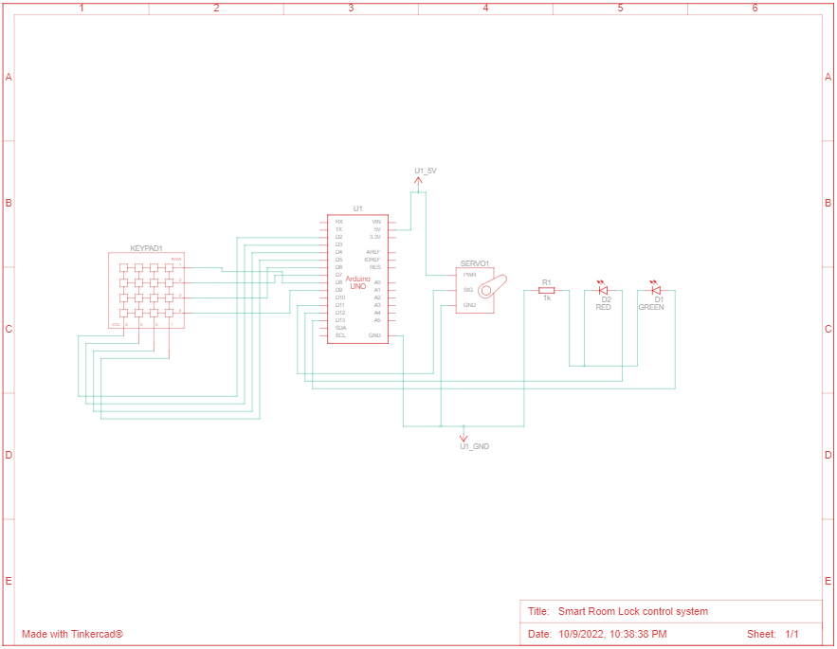
circuit design

Slide 8
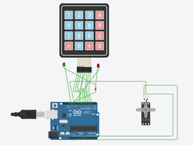
Simulation circuit diagram

Slide 9
Future plan for this project
buzzer add
fingerprint sensor add
with image

Slide 10
Conclusion
Thus “Smart Door Locking System using Arduino” is a modern successor of the conventional door locking system.The conclusion of the discussion of smart Lock using Arduino is the innovation created from the lock system with no moredirect contact between the user and the lock. This system is very cost-effective and easy to install. In conclusion, it was discovered that the project performed according to specification and can be implemented. The use of the Arduino UNO microcontroller in this project allows for design simplicity, hence, the project can be achieved in lesser time compared to other techniques previously employed. This work proposes a secure locking/unlocking system based on a keypad and Arduino. Adding password to the Arduino side increase the system security. The system also has a feature for locking itself after some delayed time. This system could be used to prevent houses, companies, institutions from stealing or losing the ordinary key.

Slide 11
Any question

Slide 12
Thanks

